Slide 1

British Airways Customer Review Analysis
Protima Tarafdar

Slide 2
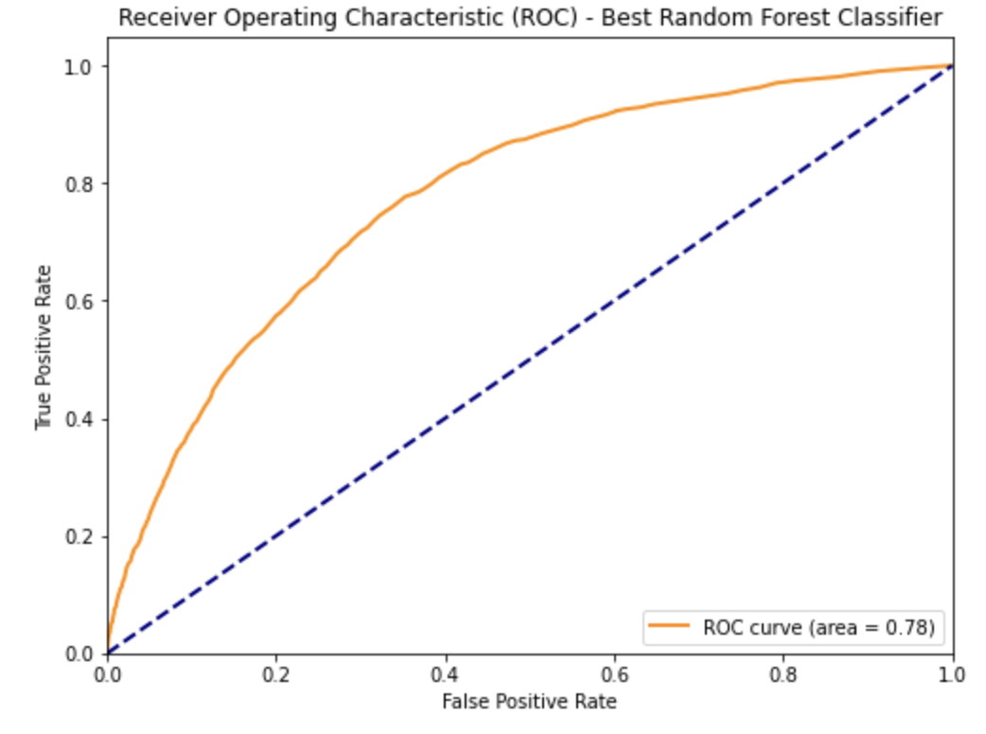
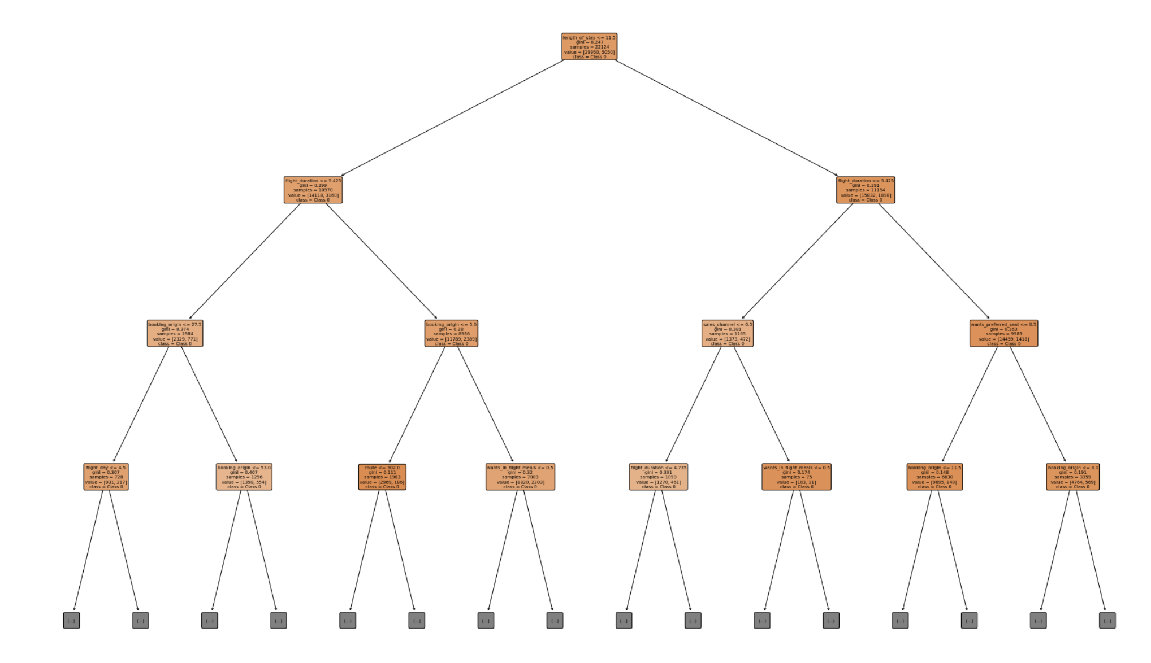
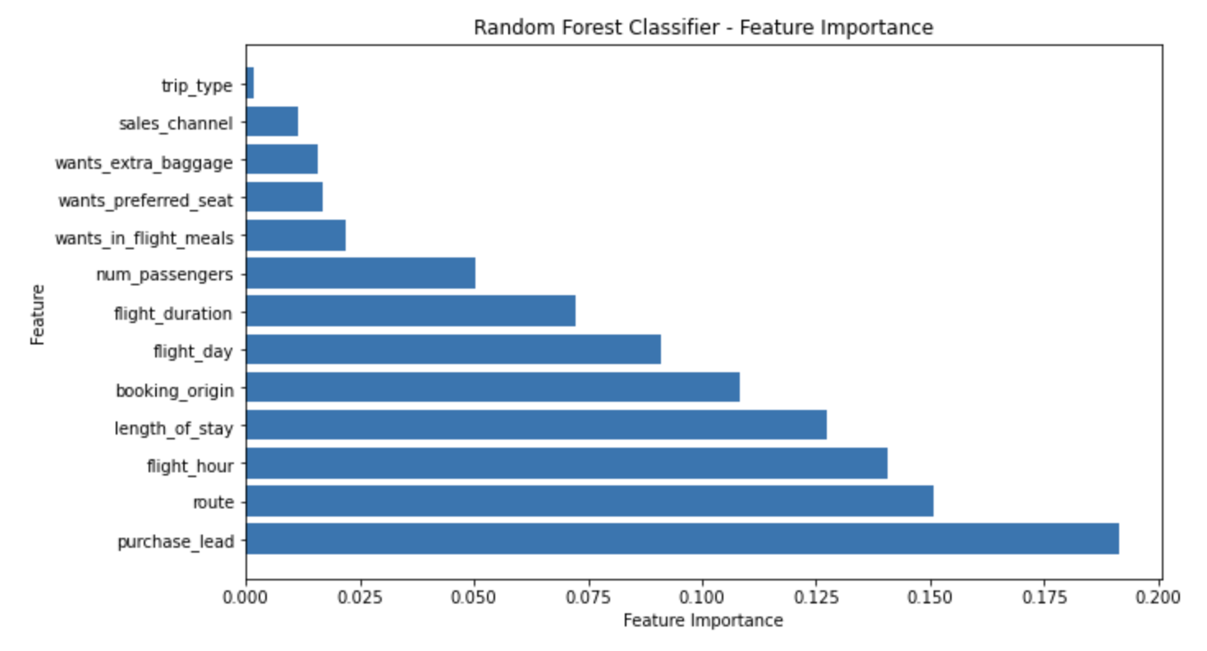
Key Findings
To predict a customer completing a booking, a random forest classifier is used with a model accuracy of 85%.
Checking the ROC curve, it is 78%.
Purchase lead, Route, Flight hour and Length of Stay, Booking Origin are the most important features to complete a booking by a customer.
It is observed that the preferences of seat/travel do not have much impact on the booking completion.

